Slide 1
Data Engineering
MapReduce and Yarn

Slide 2

Previous Day Recap
Duration - 2 minutes.
Interactive Discussion

Slide 3
Module Objectives
After completing this course you will be able to:
Understand how distributed processing works in Hadoop
Explain how Yarn manages the resources in the cluster
Apply the MapReduce model to solve daily life problems
Write MapReduce jobs in Java to solve big data problems
List the advantages of the MapReduce approach

Slide 4
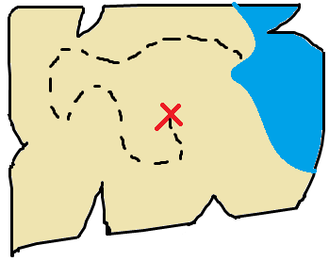

What is MapReduce?
MapReduce: Example

Slide 5

What is MapReduce
SPARK
OOZIE
ZOOKEEPER
Hadoop
MapReduce/ YARN
(Distributed Processing Framework)
PIG
FLUME
HDFS
(Hadoop Distributed File System)
MAHOUT
HIVE
SQOOP

Slide 6
What is MapReduce?
MapReduce: Example
MapReduce: Definition
MapReduce is a programming model for data processing
in a distributed framework such as Hadoop
Before we delve into MapReduce, let’s take a step back:
We will look at how individual MR jobs are managed in yarn

Slide 7

What is Yarn?
YARN stands for Yet Another Resource Negotiator
What Does YARN Do?
It decouples resource management from data processing
It is responsible for scheduling the jobs through the Resource Manager
Meaning That:
Hadoop can now simultaneously run interactive queries
while a scheduled MapReduce batch operation is running
YARN, NOT YAWN!

Slide 8
How Does Yarn Work?
The key to MR’s computational model is the ability to divide a job into small tasks!
Yarn acts as the enabler for that divide-and-conquer approach
It does so through a central daemon called resource manager
The resource manager delegates tasks to local daemons called node managers
Resource Manager
Oversees how the MapReduce jobs are divided into tasks and distributed among nodes within the cluster
Node Manager
Runs on each individual node
Is a point of failure for the Hadoop MapReduce service. If it goes down, all running jobs are halted.
The types of tasks include: map, reduce and shuffle operations
Accepts the tasks that are assigned to it and manages their execution
Performance can be improved by exploiting data locality: the data is processed where it resides, by having node managers and data nodes share the same nodes.

Slide 9
How Does MapReduce Work?
The MapReduce paradigm revolves around two main phases – map and reduce :
The input data is partitioned into multiple input splits
Each input split is mapped, or transformed, by a worker node known as a mapper
The mapping of each input split is one map task in the larger MapReduce job
Each map task in the same job does the same thing, but each on its own input
The output of each map task is a set of “key-value pairs”
All the pairs produced by all the mapper nodes are then grouped by the key
All pairs having the same key are sent to the same reducer
A reducer is yet another worker node
Its task is to reduce, or aggregate, the values in its given group
Notes:
NOTE: Unlike in Python’s dictionaries and Java’s HashMaps, keys in MapReduce need not be unique, at least until the end of the reduce phase.

Slide 10

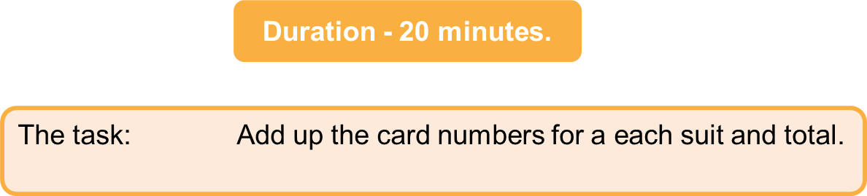
MapReduce Simulation Game

Slide 11
MapReduce Simulation Game: Solution
Delegate
Shuffle deck
Split deck
Assign each split to a trainee for mapping
Map
Mapper trainees make up to 5 piles, 1 for each suit and the discard pile
Shuffle & Sort
Grouper trainees combine the piles of like suits
Each combined pile is given to a trainee for reduction
Reduce
Reducer trainees sum the cards in their pile (2 + 3 + 4 + … + 10)
Unsurprisingly, they all get the same result (or, do they?)

Slide 12
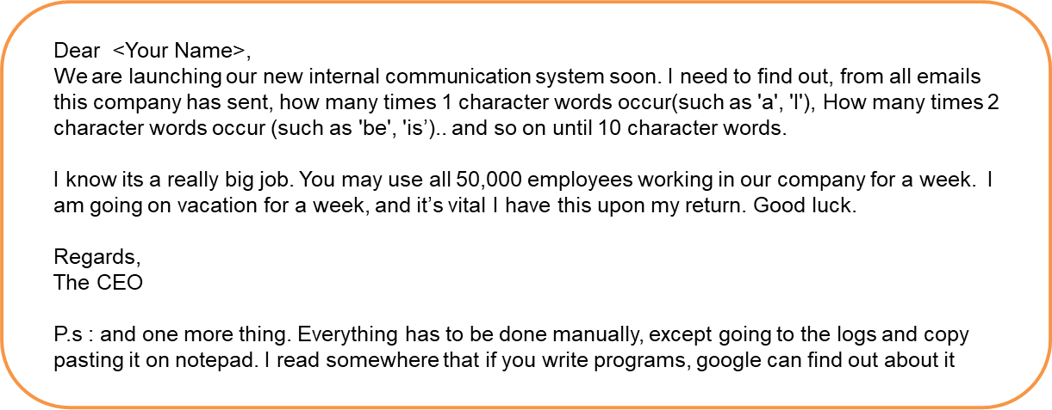
MapReduce Simulation Game 2 - CEO Email
Let’s have a look at another example!
We work for a company planning to launch an internal e-mailing system
We receive a message along the following:

Slide 13
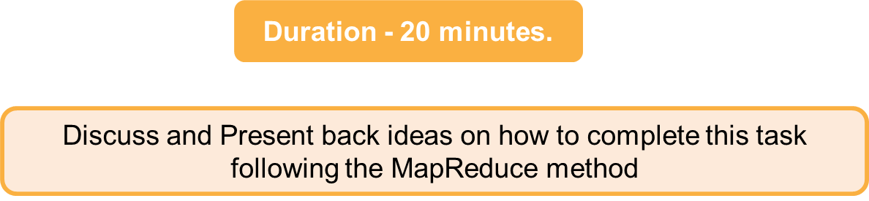
MapReduce Simulation Game 2 - CEO Email

Slide 14
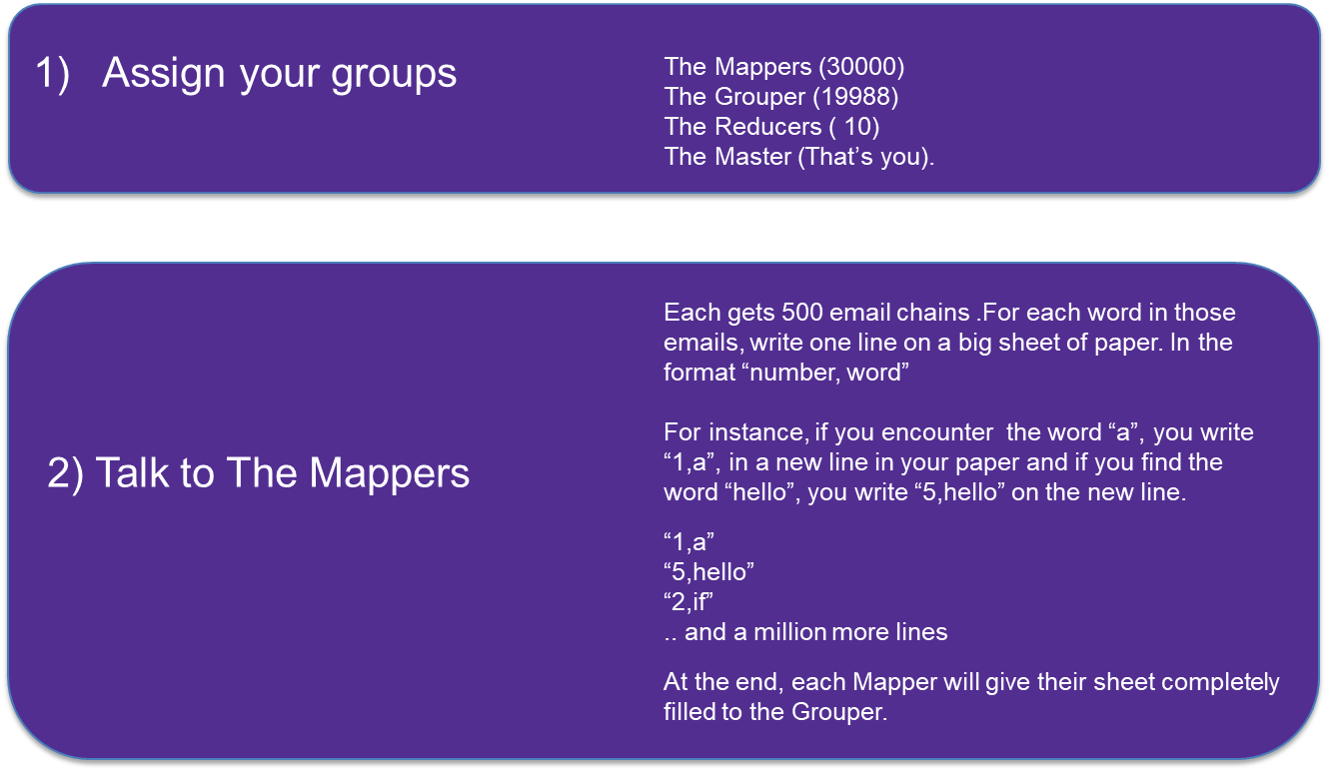
MapReduce Simulation Game 2 - Solution (Part 1)

Slide 15
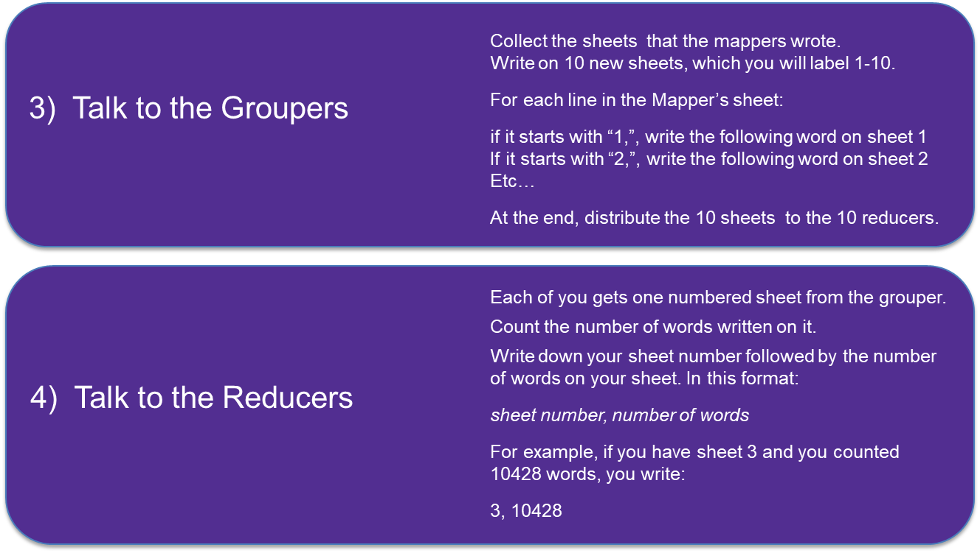
MapReduce Simulation Game 2 - Solution (Part 2)

Slide 16
MapReduce Simulation Game 2 - The End
Congratulations!!
You’ve solved the biggest challenge ever posed to you
How the story ends:
You collect the ten sheets from the ten reducers
You write your report and take it to your CEO with a big smile
“Good job!“, he says, “put it on the desk, I’ll take a look at it in a month”

Slide 17
Take-Aways and Further Remarks
A MapReduce job actually consists of five phases
Delegate, map, shuffle&sort, reduce, gather (optional)
Delegate, shuffle&sort and gather are the same for all MR jobs
A programmer only needs to develop code for map and reduce
Another optional phase called combine is sometimes added
It is used to minimize the amount of data transferred
It consists of reducing locally before grouping (shuffle&sort)
Question: is it always possible to reduce before grouping?

Slide 18
Advantages
Main Advantages of the MapReduce Computational Model
The mappers can work independently
The reducers can work independently
The work of the master and that of the grouper can be automated
The same process can be applied to many kinds of problems

Slide 19
Writing Our First MapReduce Program
The 4 steps to MapReduce Programming:
1. Write the MapReduce program in Java
2. Set Environment Variables
3. Compile and Create a jar
4. Run the application

Slide 20
Writing Our First MapReduce Program
Step 1) Write the MapReduce program in Java
import java.io.IOException;
import java.util.StringTokenizer;
import org.apache.hadoop.conf.Configuration;
import org.apache.hadoop.fs.Path;
import org.apache.hadoop.io.IntWritable;
import org.apache.hadoop.io.Text;
import org.apache.hadoop.mapreduce.Job;
import org.apache.hadoop.mapreduce.Mapper;
import org.apache.hadoop.mapreduce.Reducer;
import org.apache.hadoop.mapreduce.lib.input.FileInputFormat;
import org.apache.hadoop.mapreduce.lib.output.FileOutputFormat;
public class WordCount {
public static class TokenizerMapper
extends Mapper<Object, Text, Text, IntWritable>{
private final static IntWritable one = new IntWritable(1);
private Text word = new Text();
public void map(Object key, Text value, Context context
) throws IOException, InterruptedException {
StringTokenizer itr = new StringTokenizer(value.toString());
while (itr.hasMoreTokens()) {
word.set(itr.nextToken());
context.write(word, one);
}
}
}
public static class IntSumReducer
extends Reducer<Text,IntWritable,Text,IntWritable> {
private IntWritable result = new IntWritable();
public void reduce(Text key, Iterable<IntWritable> values,
Context context
) throws IOException, InterruptedException {
int sum = 0;
for (IntWritable val : values) {
sum += val.get();
}
result.set(sum);
context.write(key, result);
}
}
public static void main(String[] args) throws Exception {
Configuration conf = new Configuration();
Job job = Job.getInstance(conf, "word count");
job.setJarByClass(WordCount.class);
job.setMapperClass(TokenizerMapper.class);
job.setCombinerClass(IntSumReducer.class);
job.setReducerClass(IntSumReducer.class);
job.setOutputKeyClass(Text.class);
job.setOutputValueClass(IntWritable.class);
FileInputFormat.addInputPath(job, new Path(args[0]));
FileOutputFormat.setOutputPath(job, new Path(args[1]));
System.exit(job.waitForCompletion(true) ? 0 : 1);
}
}

Slide 21
Writing Our First MapReduce Program
Step 2) Set environment variables
export JAVA_HOME=../../usr/jdk64/jdk1.8.0_112 export PATH=${JAVA_HOME}/bin:${PATH} export HADOOP_CLASSPATH=${JAVA_HOME}/lib/tools.jar

Slide 22
Writing Our First MapReduce Program
Step 3) Compile and create a jar
$ hadoop com.sun.tools.javac.Main path/to/WordCount.java
$ jar cf wc.jar path/to/WordCount.class

Slide 23
Writing Our First MapReduce Program
Step 4) Run the application
$ hadoop jar wc.jar path/to/WordCount /hdfs/input/directory /hdfs/output/directory

Slide 24
Module Review
What is MapReduce?
What does the resource manager do?
Why is the decoupling of resource management and data processing important?
How does yarn take advantage of data locality?
What is the difference between data block and input split?
What are the phases of MapReduce?
What goes on during the shuffle&sort phase of MapReduce?
What are the advantages of the MapReduce approach?

Slide 25
Questions

